Slide 1
Nonverbal Communication
Efstathios Iosifidis
iosifidis@opensuse.org

Slide 2
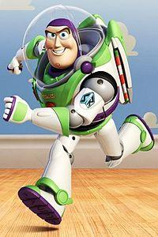
To infinity and beyond
COMMUNITY: is a group of people with the same interests.
1. Product (distro)
2. Web page (wiki, documentation)
3. Mailing list
4. IRC channel (meetings every 2 weeks)
5. Forum
6. Social media (facebook, twitter, plus, identica, connect etc)

Slide 3
NEXT LEVEL
EVENTS

Slide 4
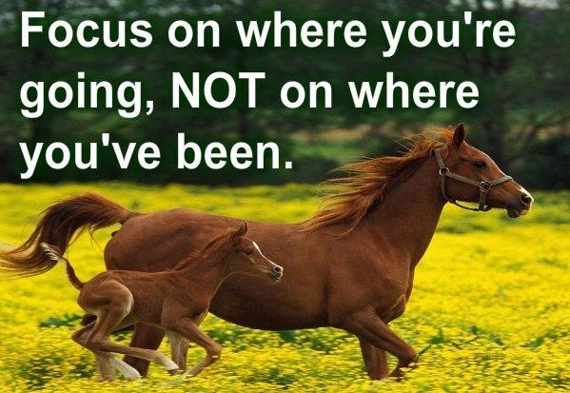
Planning for the attending events of next season

Slide 5
I'm at the event. Is that enough?
Nope.
Even if you have the most fancy booth, you must use NON verbal messages to communicate.

Slide 6
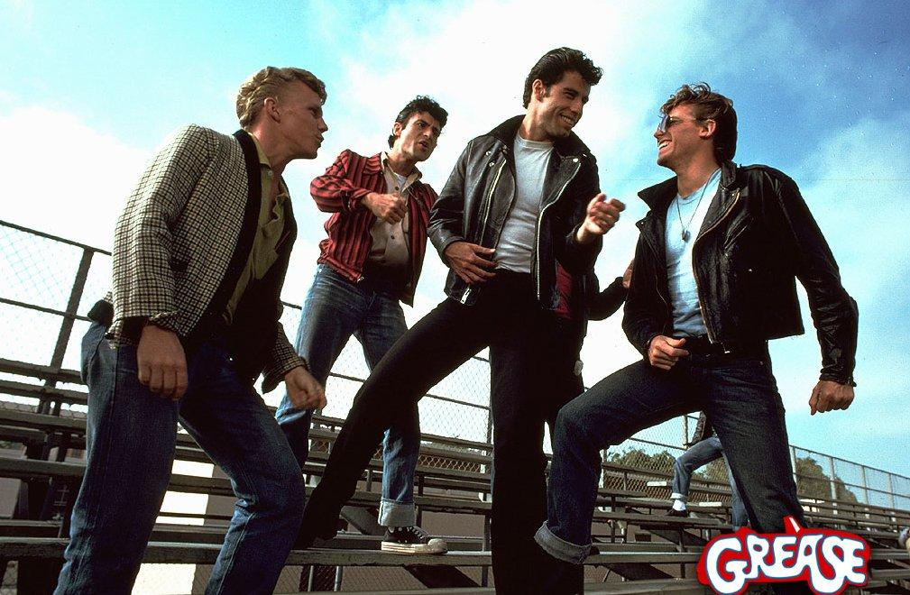
Tell me more
1. The power of the first 3-5 minutes
2. Shut up
3. Body language

Slide 7
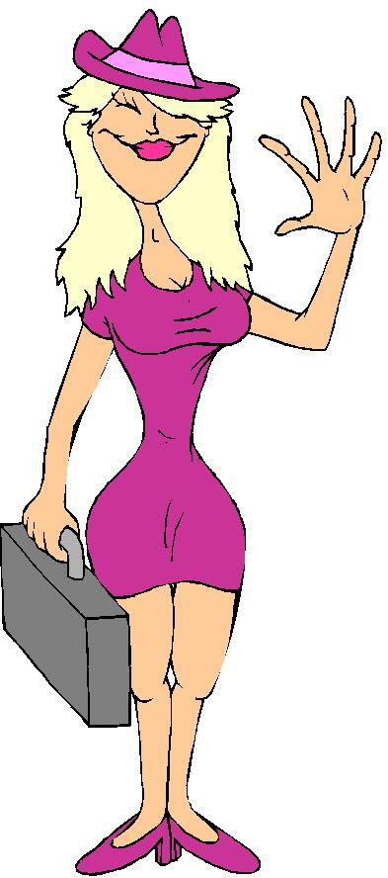
What do we see the first 3-5 minutes
- colors
- sex
- age
- size
- face expressions
- hair
- clothes
- behaviour

Slide 8
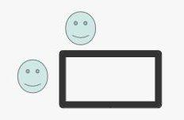
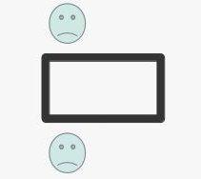
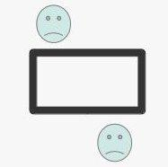
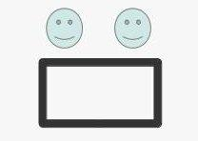
Where to stand?
Only one person should stay behind the booth. EVERYONE should stand in front of the table. WHY?
Strategic position for sales.
You observe the body language.
Opponents. It's like a wall between them.
Independent position.
Position for association-collaboration.

Slide 9
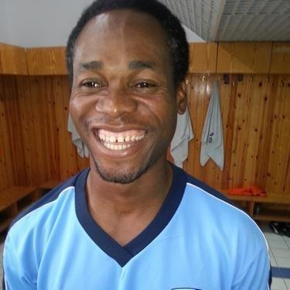
To talk or not to talk?
Visitors usually look around. They're shy.
Help them feel welcomed.
1. Be polite, smile, say good morning...
2. ASK questions to find out his/her interests.
3. SHUT UP. Let him/her speak. LISTEN.
4. SHUT UP. Let him/her speak. LISTEN.
5. SHUT UP. Let him/her speak. LISTEN.
That's why we have one mouth and two ears!!!

Slide 10
4 dominant types of personality...
How do you use this information ?
Does this help you on a booth ?

Slide 11
Personalities 1/2
According to Florence Littauer, there are four dominant types of personality:
Choleric: This is the commander-type. Cholerics are dominant, strong, decisive, stubborn and even arrogant.
Melancholy: This is the mental-type. Their typical behaviour involves thinking, assessing, making lists, evaluating the positives and negatives, and general analysis of facts.
http://en.wikipedia.org/wiki/Personality_Plus
http://www.gotoquiz.com/personality_plus_1

Slide 12
Personalities 2/2
Sanguine: This is the social-type. They enjoy fun, socialising, chatting, telling stories - and are fond of promising the world, because that's the friendly thing to do.
Phlegmatic: This is the flat-type. They are easy going, laid back, nonchalant, unexcitable and relaxed. Desiring a peaceful environment above everything.
Each personality type has its own distinctive strengths and weaknesses.
http://en.wikipedia.org/wiki/Personality_Plus
http://www.gotoquiz.com/personality_plus_1

Slide 13
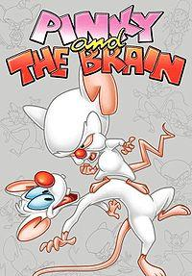
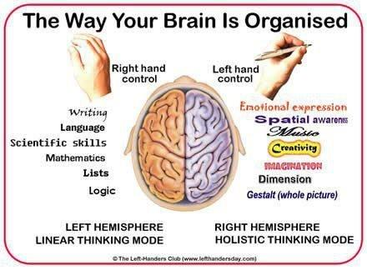
The Pinky and the Brain!!!

Slide 14
DID YOU SHUT UP? DID YOU LISTEN?
At the veterinary school I was told that asking the right questions to pet owners, you can find the diagnosis.
So learn to ask the right questions and evaluate the answers.
Then use the edification technique.

Slide 15
Edification
Since we're a team, we act like one.
I must introduce the visitor to someone from our team. HOW?
I say a few advantages of him/her (him/her studies, work, character) before the introduction.

Slide 16
Edification (continue)
During the introduction I say:
- Mr Doe, I want to introduce you to John. He's asking me about ... and I don't know. I think you can tell us something more.
What did I do? Mr Doe is at the top of mount Everest!!! Visitor listens even if Mr Doe doesn't know what he's talking about...
After a few minutes I can go.
If I meet the visitor again, I ask him if he has all the information.

Slide 17
Tutorial for the Edified
1. He can say his first name and push the visitor to use it.
2. According to the information, he can ask questions. ASK closed and positive questions.
EXAMPLES
Closed: "Meeting on Monday or Tuesday?"
We'll meet for sure but when?
Positive: "What did you like best in Gnome 3?"
This way I get only the positive information.
3. Remember names.

Slide 18
Tutorial for the Edified
4. Never accuse other distros.
Describe features of our distro.
5. Visitors ask questions (without any specific reason). The technique is to let them ask all their questions. When they finish, we ask: "OK, SOMETHING ELSE?"
"Good questions... I had the same concerns... I found out..."
Always use other people opinion... THEY DON'T BELIEVE YOU!!!

Slide 19
Body language
Albert Mehrabian and his crew found that messages and information are transmitted:
55% expressions
38% verbal (color of your voice)
7% words
SO 93% is nonverbal communication

Slide 20
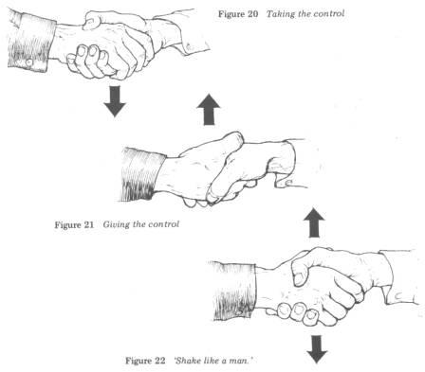
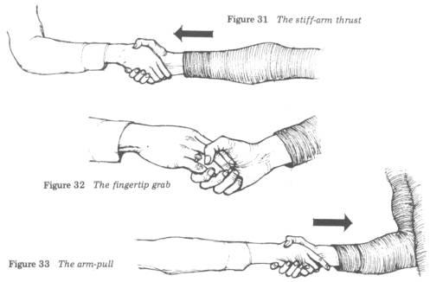
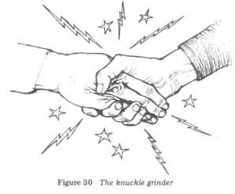
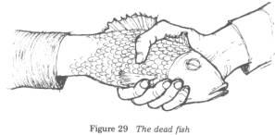
Handshake

Slide 21
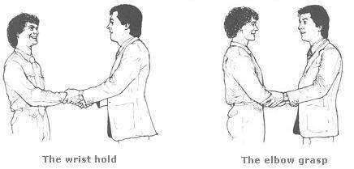
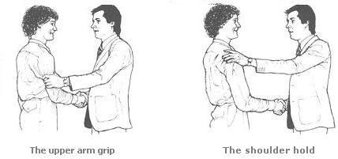
Handshake and touch
Elbow Grasp - The elbow grasp, transmits more feeling than the wrist hold, and the shoulder hold.
The shoulder hold and the upper arm grip enter the receiver’s close intimate zone and may involve actual body contact. They should be used only between people who experience a close emotional bond at the time of the handshake.

Slide 22
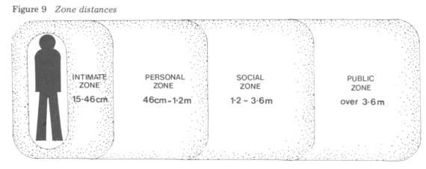
Intimate Zone (between 15 and 45 centimetres or 6 to 18 inches) - Of all the zone distances, this is by far the most important as it is this zone that a person guards as if it were his own property. Only those who are emotionally close to that person are permitted to enter it. This includes lovers, parents, spouse, children, close friends and relatives. There is a sub-zone that extends up to 15 centimetres (6 inches) from the body that can be entered only during physical contact. This is the close intimate zone.
Personal Zone (between 46 centimetres and 1.22 metres or 18 to 48 inches) - This is the distance that we stand from others at cocktail parties, office parties, social functions and friendly gatherings.
Social Zone (between 1.22 and 3.6 metres or 4 to 12 feet) - We stand at this distance from strangers, the plumber or carpenter doing repairs around our home, the postman, the local shopkeeper, the new employee at work and people whom we do not know very well.
Public Zone (over 3.6 metres or 12 feet) - Whenever we address a large group of people, this is the comfortable distance at which we choose to stand.

Slide 23
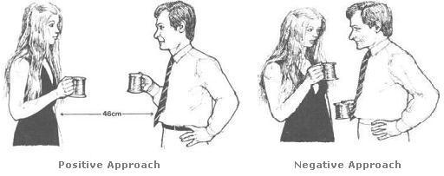
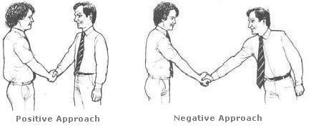
Zones

Slide 24
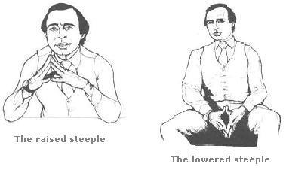
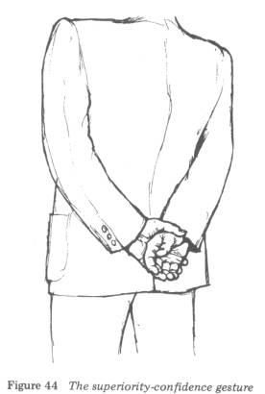
Hands
The Raised Steeple - The position is normally taken when the steepler is giving his opinions or ideas and is doing the talking.
The Lowered Steeple - The position is normally used when the steepler is listening rather than speaking.

Slide 25
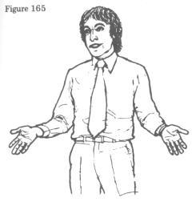
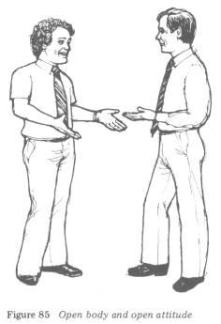
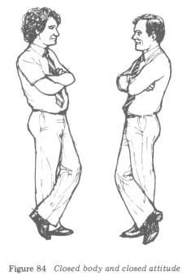
Open-Closed attitude
TIP: Touch the arm of your visitor for 2 secs and tell him "Check out our booth". He'll feel welcomed, like someone hug him.

Slide 26
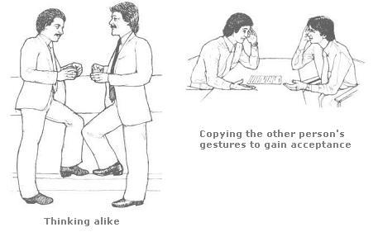
Mirroring
This 'carbon copying' is a means by which one person tells the other that he is in agreement with his ideas and attitudes. By this method, one is non-verbally saying to the other, 'As you can see, I think the same as you, so I will copy your posture and gestures.'

Slide 27
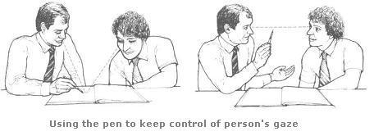
Controlling a person's gaze
To maintain maximum control of his gaze, use a pen or pointer to point to the visual aid and at the same time verbalise what he sees. Next, lift the pen from the visual aid and hold it between his eyes and your own eyes. This has the magnetic effect of lifting his head so that he is looking at your eyes and now he sees and hears what you are saying, thus achieving maximum absorption of your message.

Slide 28
Non verbal communication represent more than 90 % of exchanges
Talk less and listen more
A smile has more impact than long explanations

Slide 29
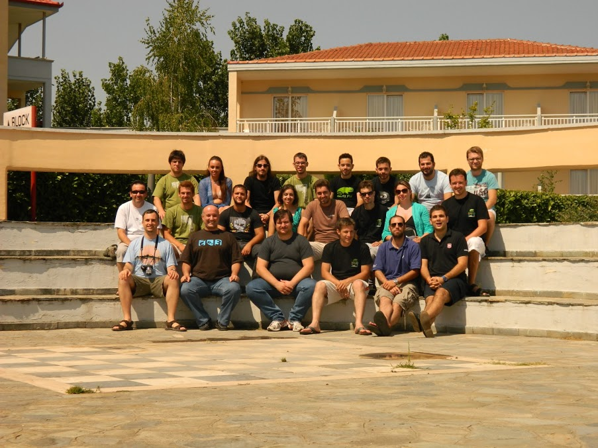
2nd openSUSE Collaboration
Summer Camp 2012

Slide 30
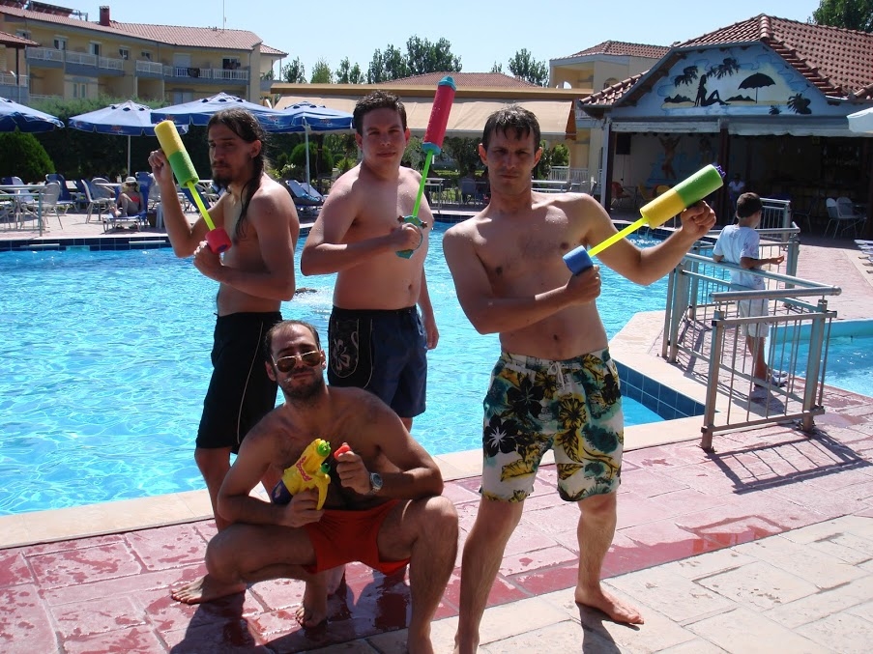
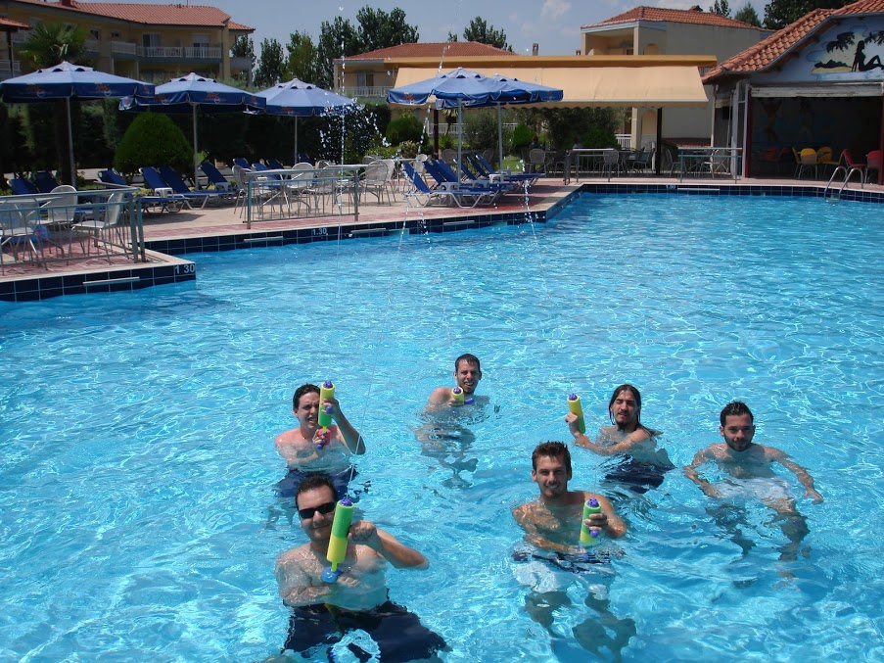
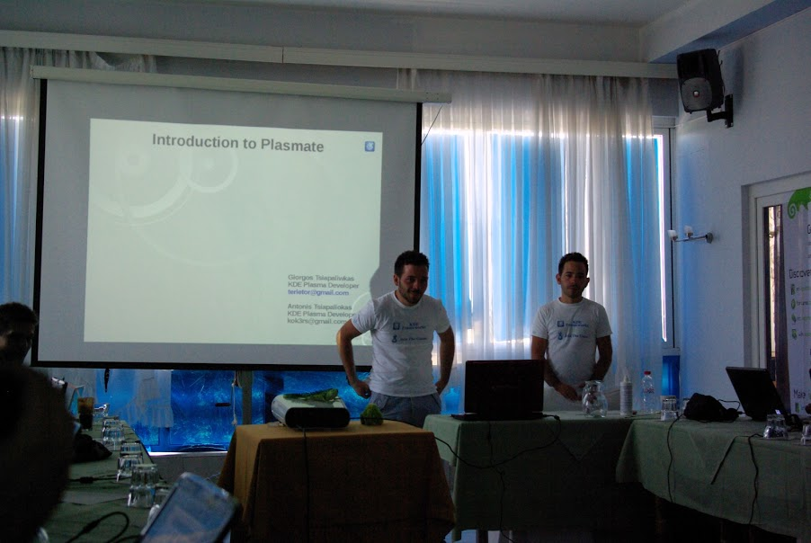
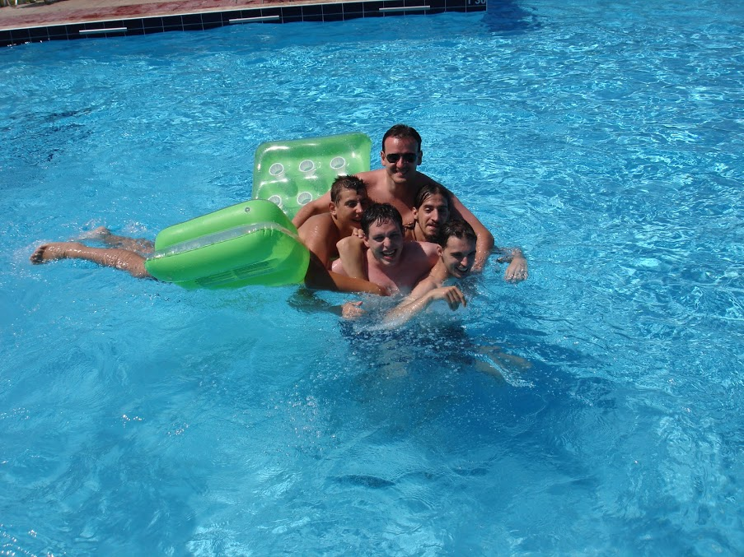

Slide 31
oSC 2013
Tomorrow (Tuesday October 23rd)
Room: Picard
@ 14:00

Slide 32

Thanks for your attention, questions?

